Slide 1
Eco Beach Resorts
Eco Container Home Project Ghana
Ghana’s First Green Community
To Inspire, educate, support and create.
Our aim is to set up new eco friendly communities and services using natural systems and procedures that are working in harmony with the environment, affordable, sustainable and in balance with nature. We aim to inspire and educate others, encouraging them to work with us or do the same in being catalyst and an example to their community.
2-5+ Bedroom Houses
Using shipping containers and other natural material
By Freda Gaisie

Slide 2
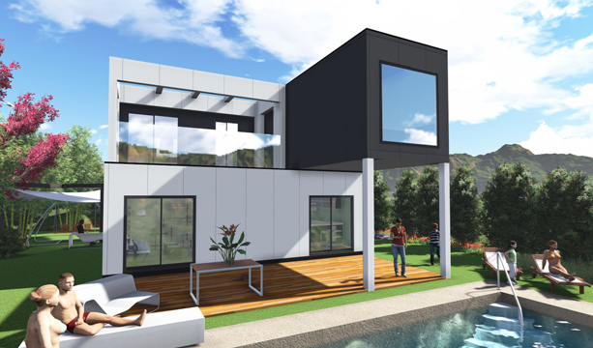
Design /Example
3 Bedrooms, 2 bathrooms total 130 square meters

Slide 3
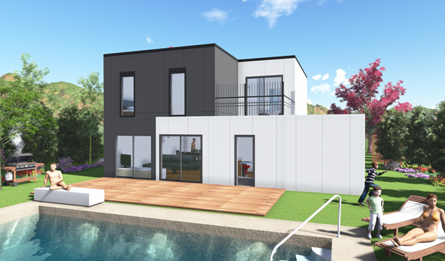
Design /Example
3 bedrooms, 2 bathrooms total 125 square meters

Slide 4
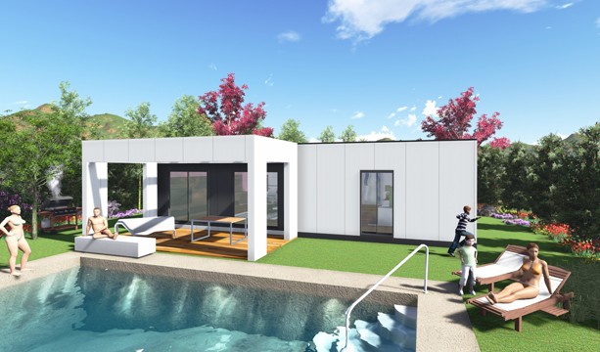
Design /Example
2 bedrooms, 1 bathroom total 120 square meters

Slide 5
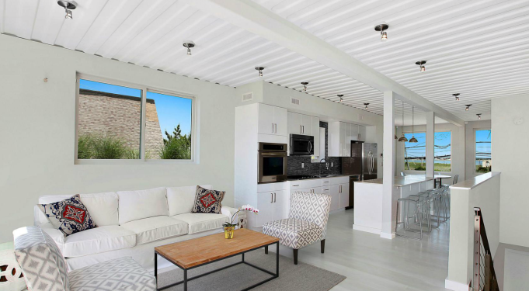
Living Room Example
This is an actual 3 bed shipping container design

Slide 6
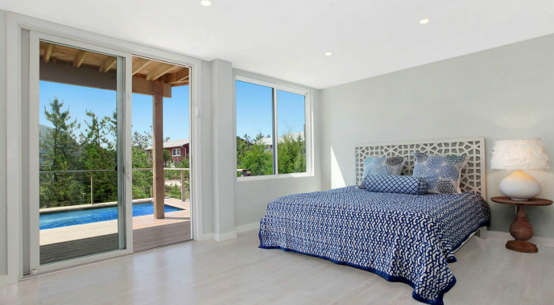
Bedroom 1 Example

Slide 7
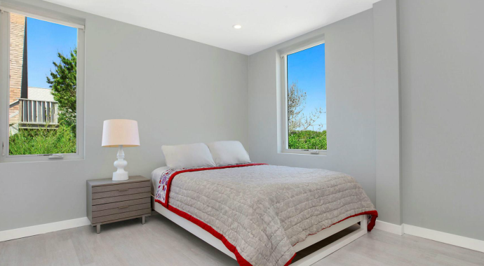
Bedroom 2 Example

Slide 8
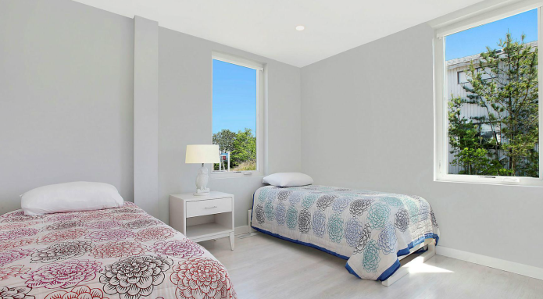
Bedroom 3 Example

Slide 9
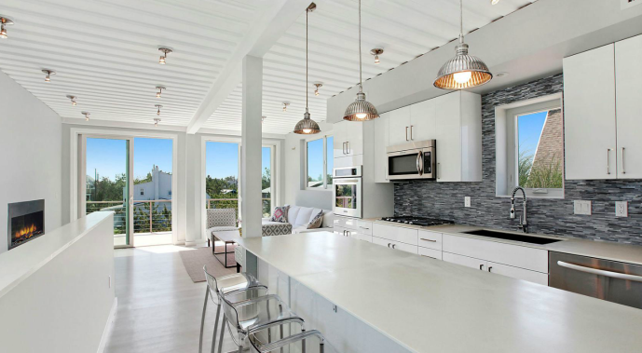
Kitchen Example

Slide 10
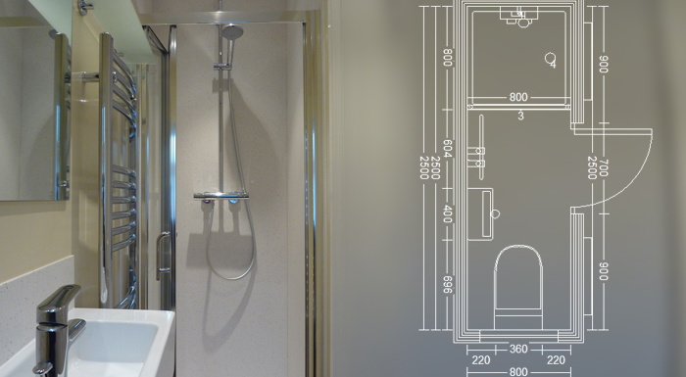
Shower Room Example

Slide 11
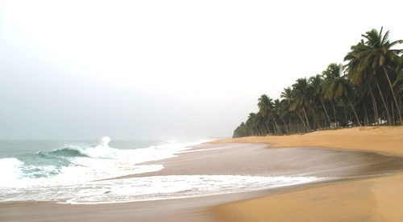
Beach Land For Project

Slide 12
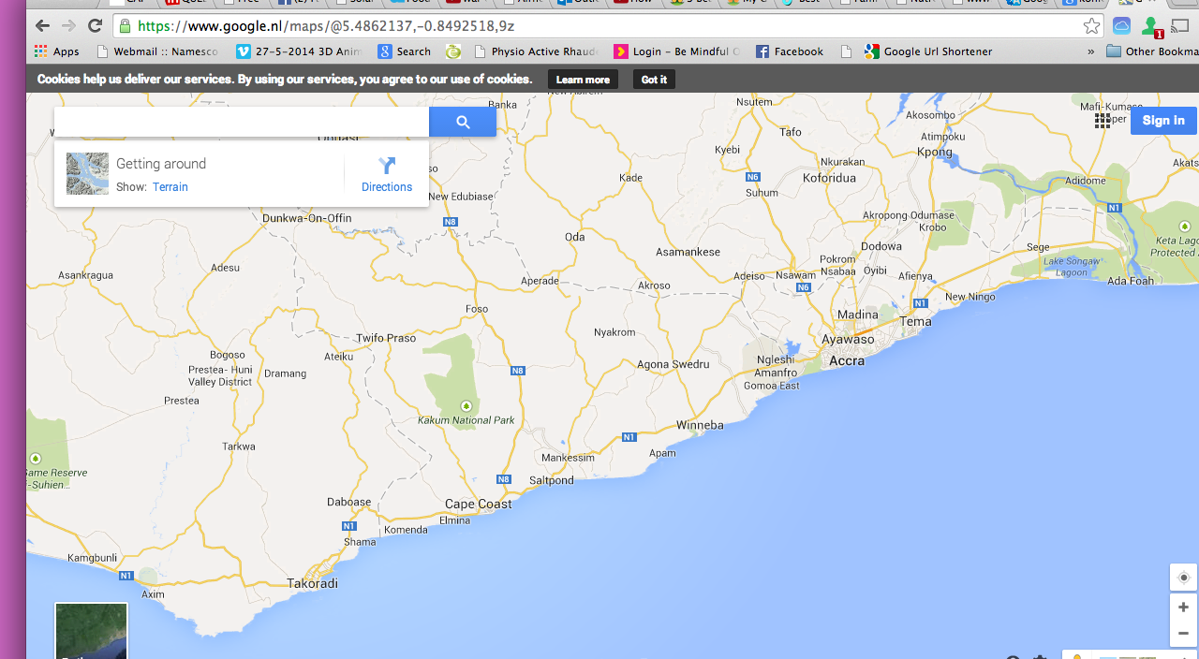
Map of Region

Slide 13
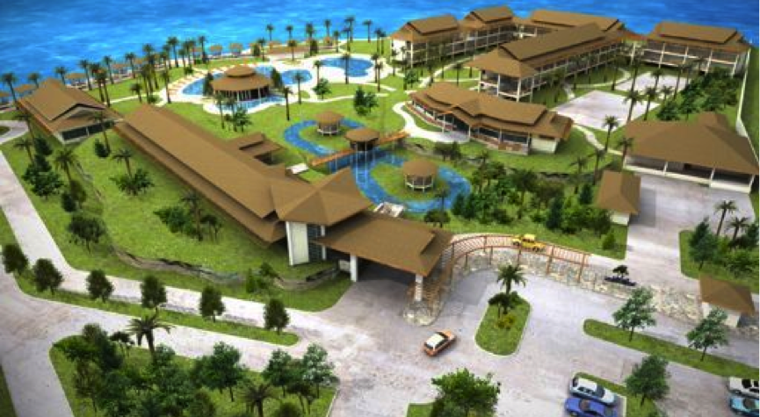
Green Community Model Example

Slide 14
Design Process Flow Chart-Inception
Acquire & Inspect Land
Get Planning
Building Plans
Green Architect & Construction Company
Locate Containers

Slide 15
Design Process Flow Chart-Planning
Marketing Brochure
Off-Plan Structure
Site Manager
Appoint Interior Designer
Construction Training of Locals

Slide 16
Design Process Flow Chart-Sustainability
Clean up environment
Water Connection
Solar and Wind Power
Identify Green Building Material
Back-up Generators

Slide 17
Design Process Flow Chart-Management
General Manager
Project Manager
Supervisor
Advisor
Project Director

Slide 18
Project Experts
Architect/Interior design
Renewable energy experts
Marketing/Graphic design
Container home expert
Investors/New project expert

Slide 19
Design Process Flow Chart-Projects
Homes
Retreat & Spa
Shops & Restaurants
Services
Hotel

Slide 20
Design Process Flow Chart-Community Support
Educational Centre
Health Centre
Internet Cafe
EmergenciesHospital
Social Hub

Slide 21
Local Community
Decent Homes
Jobs
Training & Social Activities
Agriculture
Business

Slide 22
Social Activities
Transport
Excursions
Activity
Social
Media

Slide 23
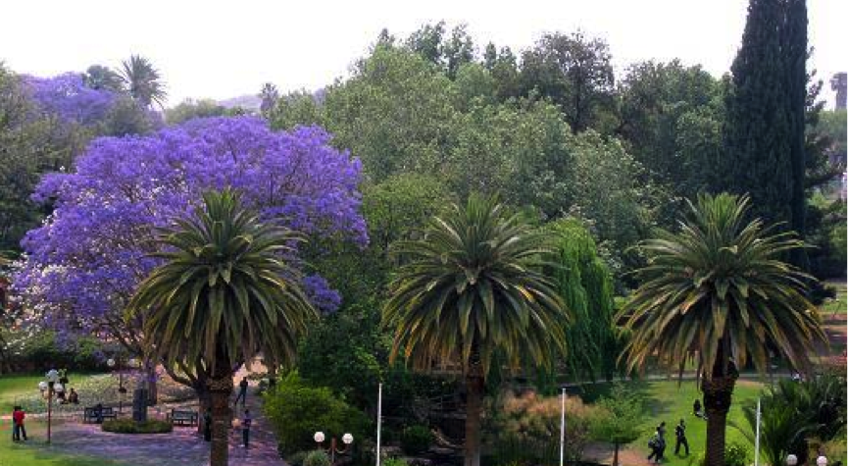
Park and Gardens Example

Slide 24
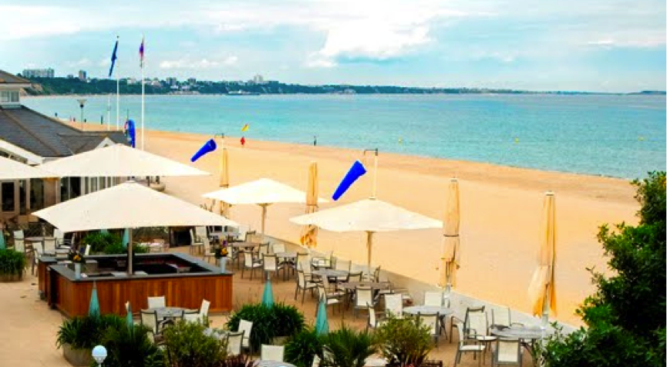
Beach Bar & Café Example

Slide 25
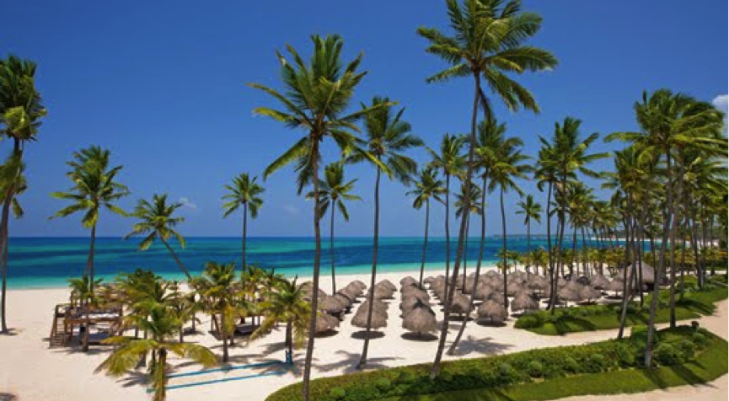
Beach Relaxation

Slide 26
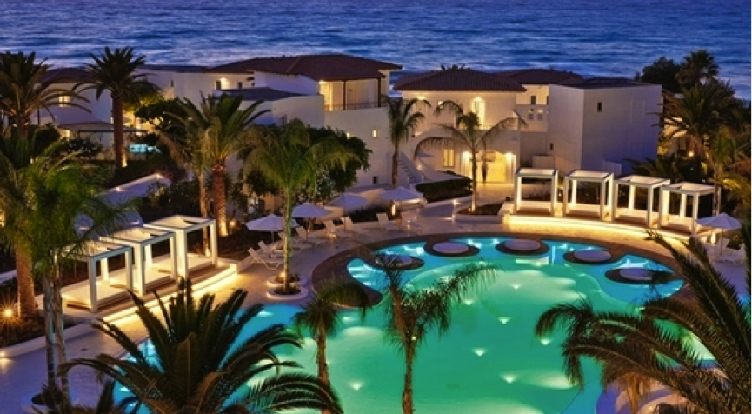
Eco Beach Hotel Example

Slide 27
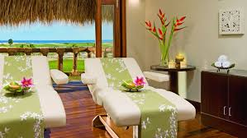
Eco Beach Spa Example

